Slide 1
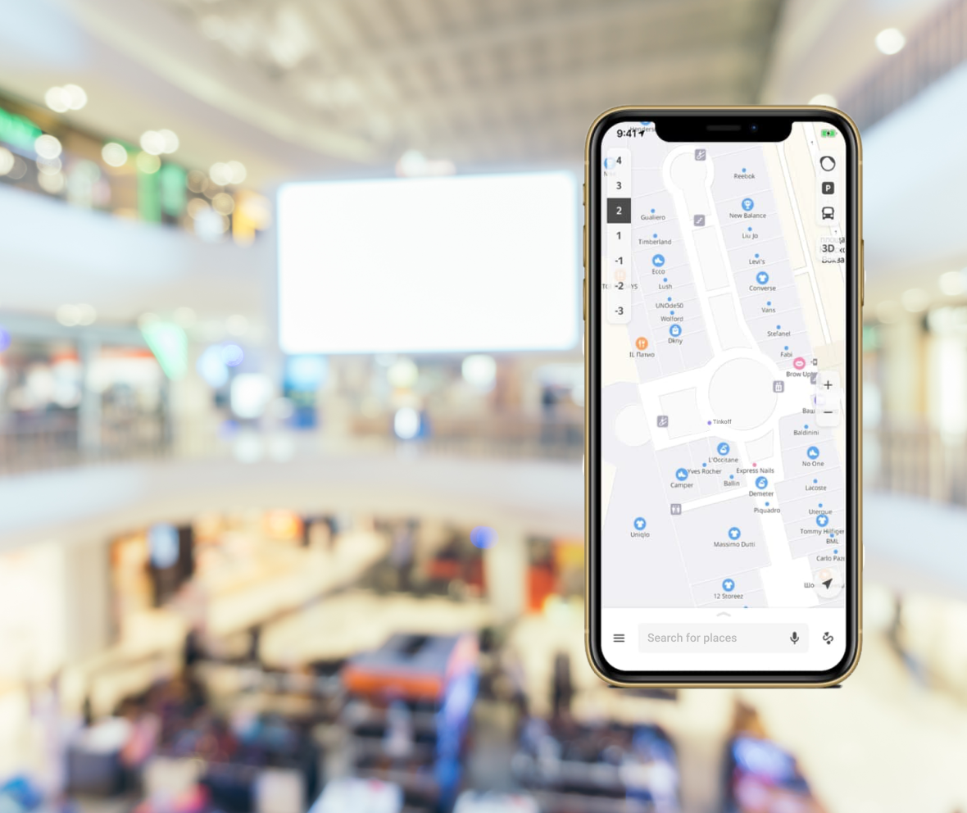
MALLTRAILS
KIAN ANSARINEJAD
EMIRHAN TORPAK
EREN KÖSEN
MURAT GÖÇMEN
SABAHADDIN ISPIROĞLU

Slide 2
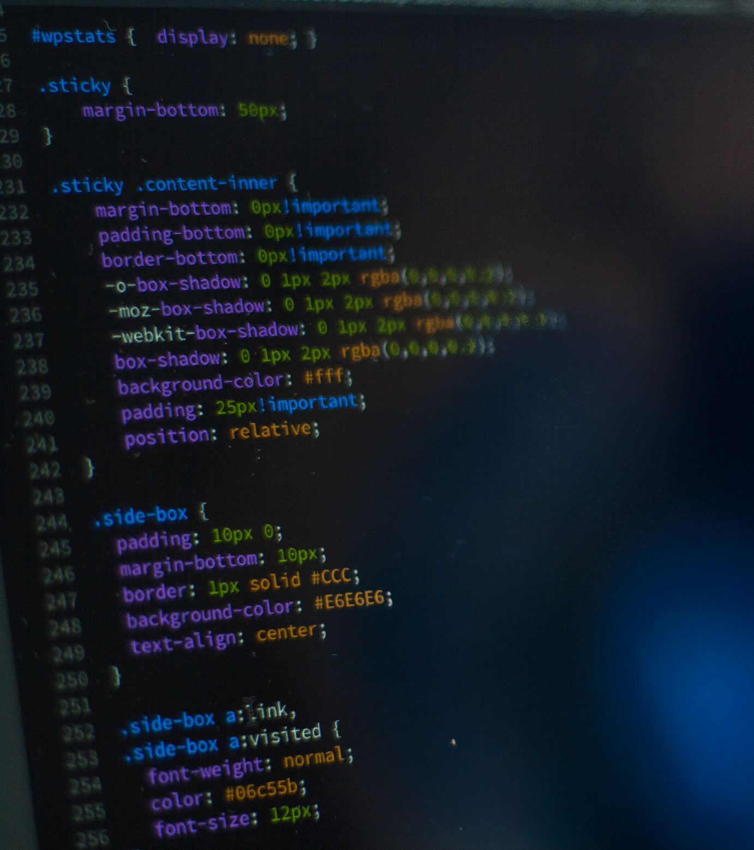
FUNCTIONAL REQUIREMENTS
8 Functional Requirements
The app should provide a map for each Mall with the ability to search each store in the selected Mall.
NON-FUNCTIONAL REQUIREMENTS
6 Non-Functional Requirements
The app should be less than 50 MB for easy installation.
Application should work on at least Android 10 & IOS 13 and up-to-date versions.

Slide 3








STAKEHOLDERS
Shoppers
Developers
Government
Project
Managers
Mall Management
Brands
Investors
Data
Providers

Slide 4










PROJECT STAFFING
Developers
Project
Manager
Business
Analyst
Test & QA
Engineer
Designers

Slide 5
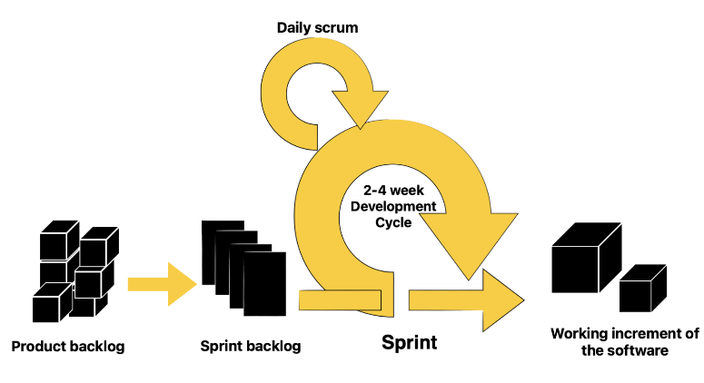
SOFTWARE PROJECT MODEL: AGILE (SCRUM)
MAIN REASONS
Faster Time to Market
2. Increased Transparency
3. Flexibility To Change
4. Higher Quality

Slide 6
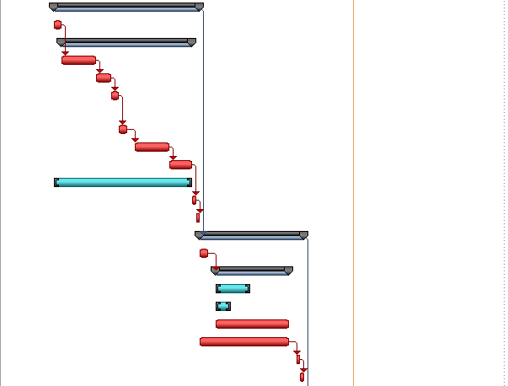
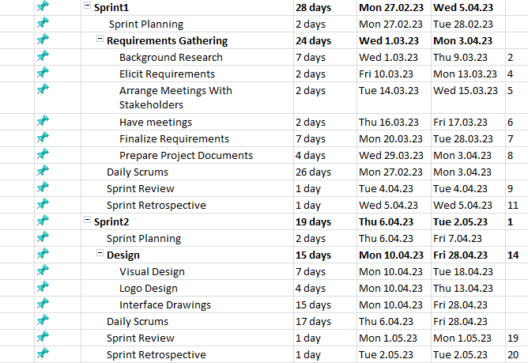
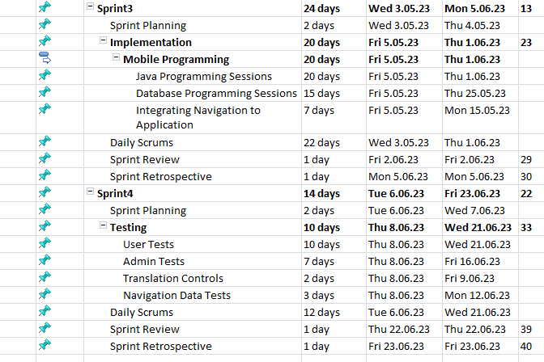
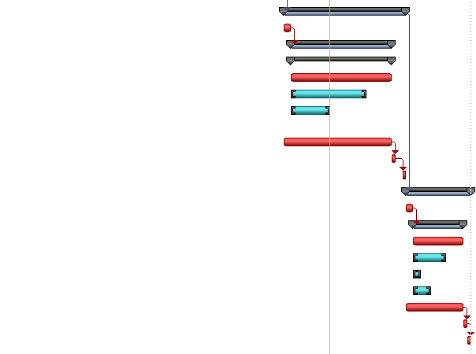
PROJECT SCHEDULE

Slide 7
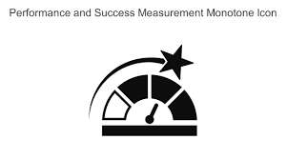

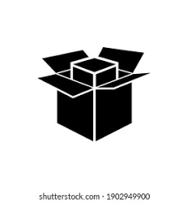
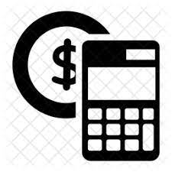

SOFTWARE MEASUREMENTS
Performance
Intellij IDEA
Figma
Communication
Product Size
Number of meetings held
Lines of code
Number of modules
Project Management
Cost and Effort Estimation
Project length
Cost of project
Person-hours spent on coding

Slide 8

PROJECT RISKS
Staff Turnover
Insufficient Training
Communication Challenges
Security Risks
Schedule Delays
Requirements Change
Budget Overruns
Technical Issues

Slide 9




SOFTWARE NEEDS AND TOOLS
Intellij IDEA(Version 2023.1.2)
Figma(107.0.0)
Microsoft Word(Version 2304)
Android(10th Version)
Java SDK(20th Version)
Firebase(20.3.2)
Git (Version Control System-2.40.1)
Google Maps(6.66.0 )

Slide 10



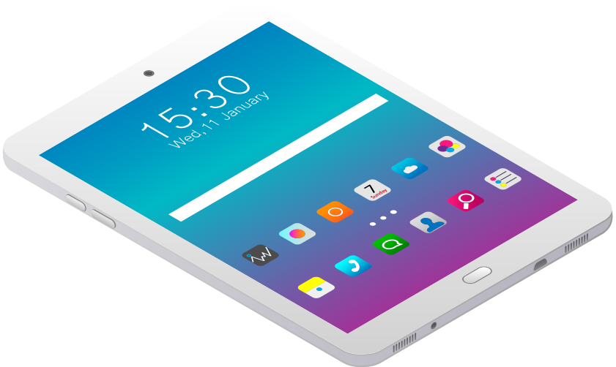
HARDWARE NEEDS
Phones(IOS/Android)
PC/Laptop
All-in-one Printer
Pc input devices (mouse, keyboard, microphone etc.)
Tablet
PC output devices (monitors, speakers, etc)

Slide 11

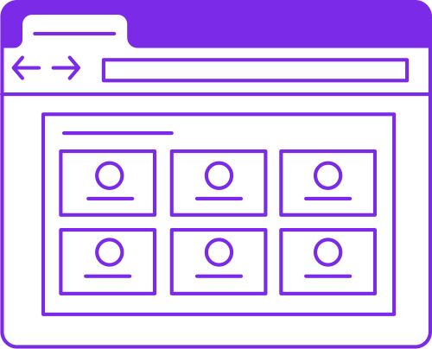
SUPPORT NEEDS
JetBrains support team
Microsoft support team (Office/Windows)
Investors
Firebase support team
Technical writers
Marketing experts
User Experience (UX) Designers

Slide 12
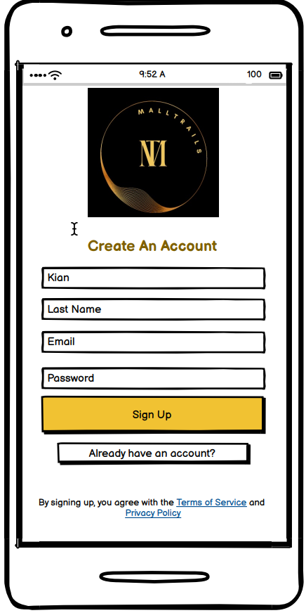
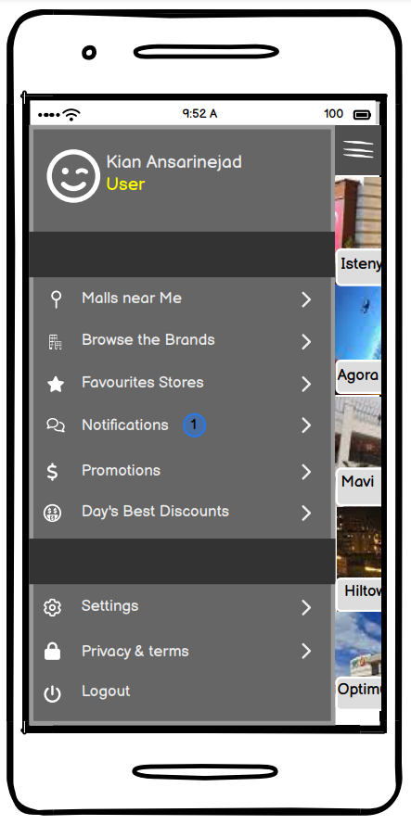
GRAPHICAL USER INTERFACE (GUI)
Login Page
For main page, user must create an acocunt to use the application.
Main Menu
Features
Malls near the user
Favorite Stores
Search brand-specific
Promotions and Deals

Slide 13
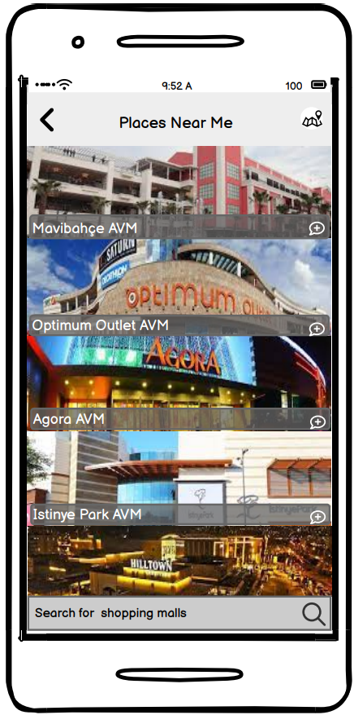
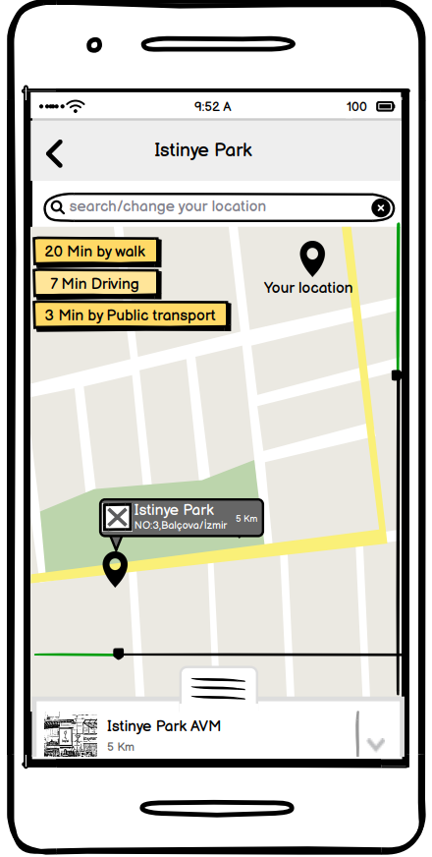
Location Based Mall and Map
Application can find the malls near the user via location
Map
After the mall is chosen, it can show the distance and time based on various transport vehicles.

Slide 14
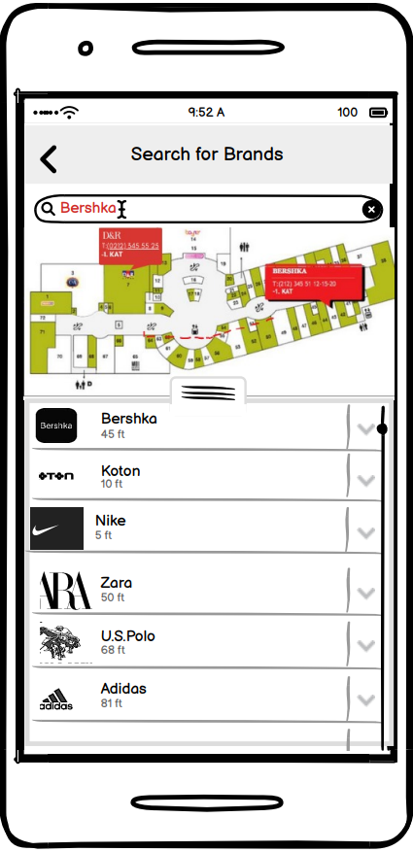
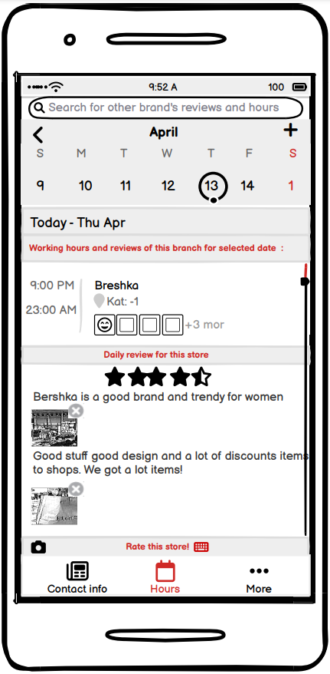
Brand Search
Application can find the malls near the user via location
Rate and Comment
User can see the availability of the shop, rate and comment the shops.

Slide 15
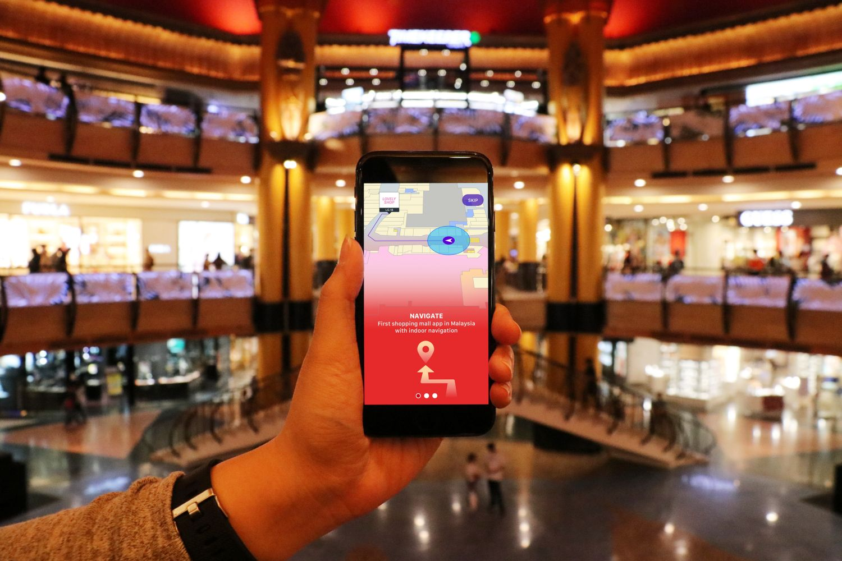

MALLTRAILS
M
T

Slide 16

MALLTRAILS
M
T
MALLTRAILS
THANKS FOR LISTENING

